Slide 1
Module 2: MACHINE TOOL Operations

Slide 2
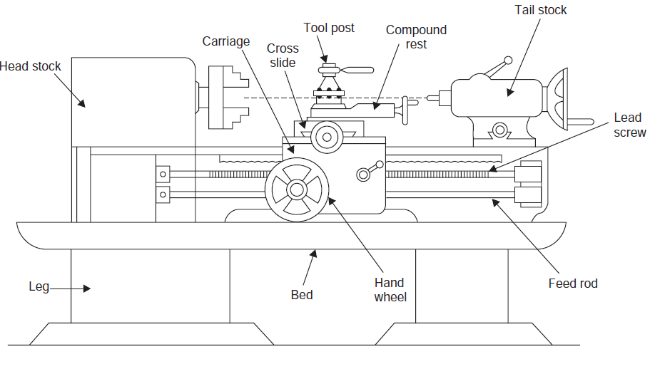
Engine lathe or center lathe

Slide 3
Bed: It is the main body of the machine. All main components are bolted on it. It is usually made by cast iron due to its high compressive strength and high lubrication quality. It is made by casting process and bolted on floor space.
Tool post : It is bolted on the carriage. It is used to hold the tool at correct position. Tool holder mounted on it.
Chuck: Chuck is used to hold the workspace. It is bolted on the spindle which rotates the chuck and work piece. It is four jaw and three jaw according to the requirement of machine.
Head stock : Head stock is the main body parts which are placed at left side of bed. It is serve as holding device for the gear chain, spindle, driving pulley etc. It is also made by cast iron.
Tail stock : Tail stock situated on bed. It is placed at right hand side of the bed. The main function of tail stock to support the job when required. It is also used to perform drilling operation.
Lead screw : Lead screw is situated at the bottom side of bed which is used to move the carriage automatically during thread cutting.
Carriage : It is situated between the head stock and tail stock. It is used to hold and move the tool post on the bed vertically and horizontally. It slides on the guide ways. Carriage is made by cast iron.
Apron : It is situated on the carriage. It consist all controlling and moving mechanism of carriage.

Slide 4
WORKING PRINCIPLE OF Lathe
A lathe is a machine tool which is used to remove unwanted metals from the work piece to give desired shape and size.
It operates on the principle of a rotating work piece and a fixed cutting tool.
The cutting tool is feed into the work piece which rotates about its own axis causing the workpiece to form the desired shape.
The main function of Lathe machine is to remove excess material in the form of chips by rotating the work piece against a stationary cutting tool.
This is accomplished by holding the work securely and rigidly on the machine and then turning it against cutting tool which will remove metal from the work.
To cut the material properly the tool should be harder than the material of the work piece, should be rigidly held on the machine and should be fed or progress in a definite way relative to the work.

Slide 5
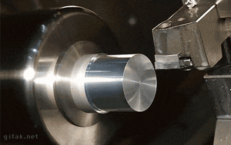

Lathe operations
1.Turning
In this operation feed is given parallel and depth of cut is perpendicular to the axis of rotation.
The workpiece is fixed inside the chuck and tool is fed against to the rotating workpiece.
This operation is done to remove the material on the cylindrical surface. This operation will reduce the diameter of the workpiece.

Slide 6
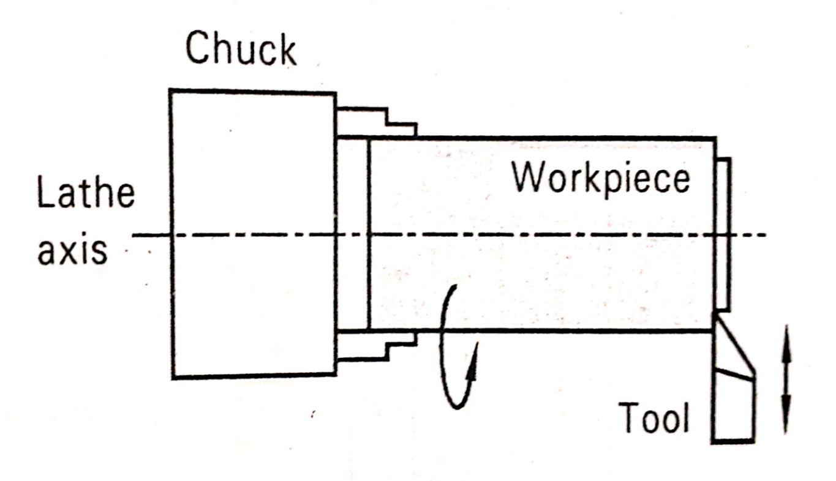
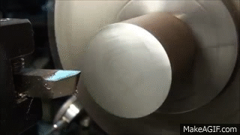
2. Facing
In this operation feed is given perpendicular and depth of cut is parallel to the axis of rotation.
The workpiece is fixed inside the chuck and tool is fed against to the rotating workpiece.
This operation is done to remove the material on the face of the workpiece. This operation will reduce the length of the workpiece.

Slide 7
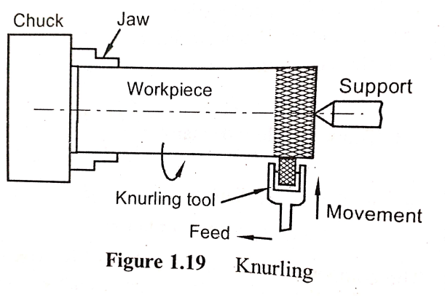
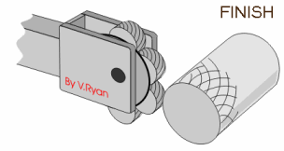
3. Knurling
In this operation feed is given parallel and depth of cut is perpendicular to the axis of rotation.
The workpiece is fixed inside the chuck and tool is fed against to the rotating workpiece.
This operation is done to impart diamond shaped engraves in the cylindrical surface o the workpiece.
Ex: Products that require gripping, such as hand tools, are often knurled to improve their performance and usability.

Slide 8
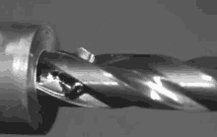
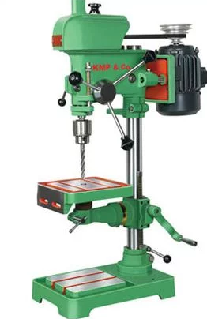
DRILLING
Working Principle of Drilling Machine
Drilling is a metal cutting process carried out by a rotating cutting tool to make circular holes in solid materials. The tool which makes the hole is called a drill.
It is generally called as twist drill, Since it has a sharp twisted edges formed around a cylindrical tool provided with a helical groove along its length to allow the cut material to escape through the sharp edges of the conical surfaces ground at the lower end of the rotating twist drill cuts the material by peeling it circularly layer by layer when forced against a work piece.
The removed material chips get curled and escapes through the helical groove provided in the drill. A liquid coolant is generally used while drilling to remove the heat of friction and obtain a better finish for the hole.

Slide 9
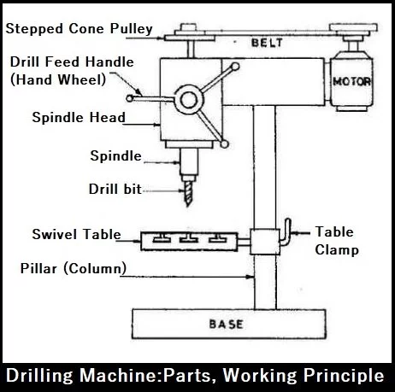
Figure: Construction and parts of drilling machines

Slide 10
Base: It is the main body of the machine. All main components are bolted on it. It is usually made by cast iron due to its high compressive strength and high lubrication quality. It is made by casting process and bolted on floor space.
Column: It support for rotating the Swivel table and holding the power transmission system.
Swivel Table: It is attached to the column which can hold the machine vice on which the work pieces are clamped carry out the drilling operation. The Swivel table can move up and down as well as rotate about the column as axis. This can be done by means of rotational motion and can be locked to the column by means of locking nut.
Drill Feed Handle: By the rotation of hand-wheel, the spindle moves up and down in the vertical direction in order to give the necessary amount of feed to the work.
Spindle: It is used to hold the drill. This spindle is connected to motor shaft. Once the motor is switched on the spindle starts rotating.
Power Transmission system: To control the speed of the tool rotation, power transmission system is used. It consists of motor, stepped pulley, V-belt, and the Spindle.

Slide 11
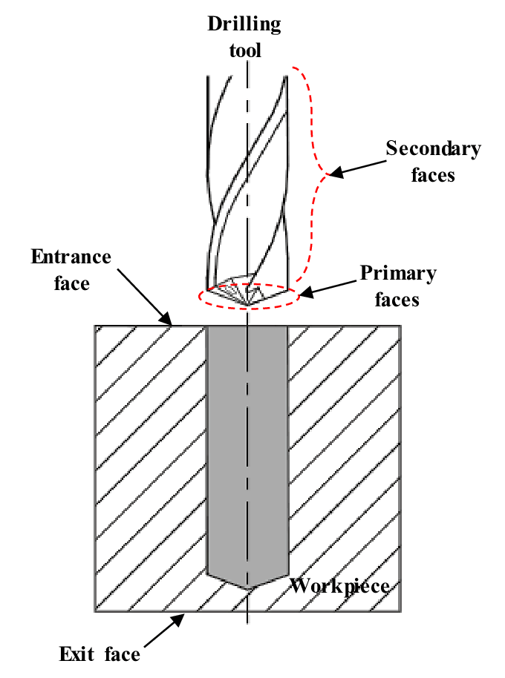
Drilling
Drilling is the operation of producing a cylindrical hole by removing metal from the rotating edge of a cutting tool called the drill.
The centre of the hole is located on the workpiece by drawing two lines at right angles to each other and then a centre punch is used to produce an indentation at the centre.
The drill point is pressed at this centre point to produce the required hole.
The internal surface of the hole so generated by drilling becomes rough and the hole is always slightly oversize than the drill used due to the vibration of the spindle and the drill.

Slide 12
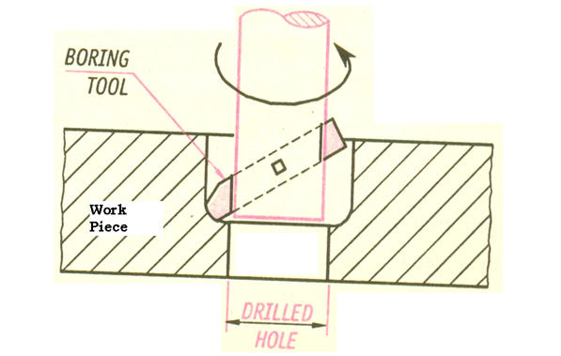
BORING
Boring is done on a drilling machine to increase the size of an already drilled hole.
When a suitable size drill is not available, initially a hole is drilled to the nearest size and using a single point cutting tool, the size of the hole is increased as shown in Fig.
By lowering the tool while it is continuously rotating, the size of the hole is increased to its entire depth.
Fig shows when the boring operation is in progress. It will be continued till the lower surface of the work piece.

Slide 13
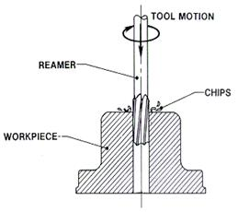
REAMING
Reaming is the process of smoothing the surface of the drilled holes with a reamer.
A reamer is similar to the twist drill, but has straight flutes.
After drilling the hole to a slightly smaller size, the reamer is mounted in place of twist drill and with the speed reduced to half of that of the drilling, reaming is done in the same way as drilling.
It removes only a small amount of material and produces a smooth finish on the drilled surfaces.

Slide 14
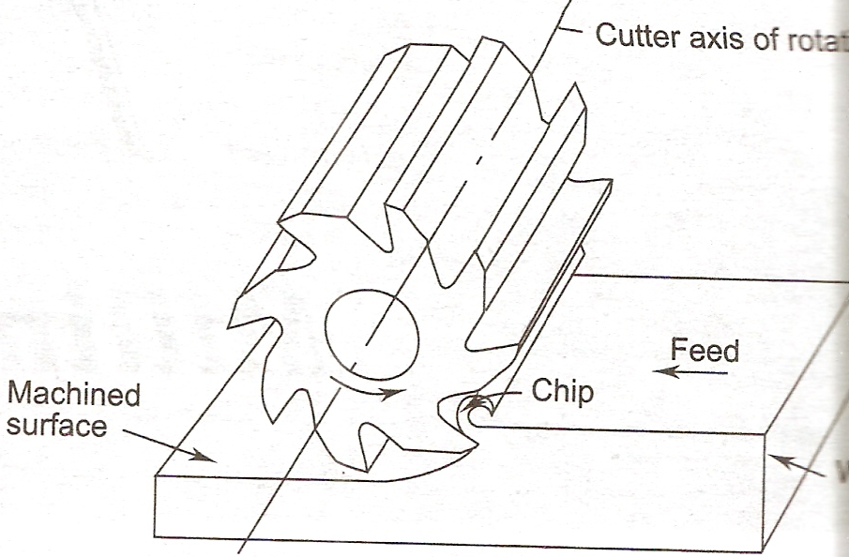
WORKING PRINCIPLE OF MILLING MACHINE
Definition:- A machine tool used for removing the undesirable material from a workpiece by feeding the workpiece against a rotating multipoint cutting tool called milling cutter.

Slide 15
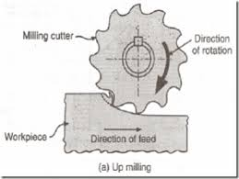
Working Principle of Milling Process:
Workpiece is clamped on the work table.
Milling cutter is mounted on the arbor or spindle of milling machine.
Milling cutter rotates at desired speed.
Workpiece is fed against the rotating milling cutter by moving in X,Y and Z directions.
Milling cutter is made up of material harder than the workpiece.

Slide 16
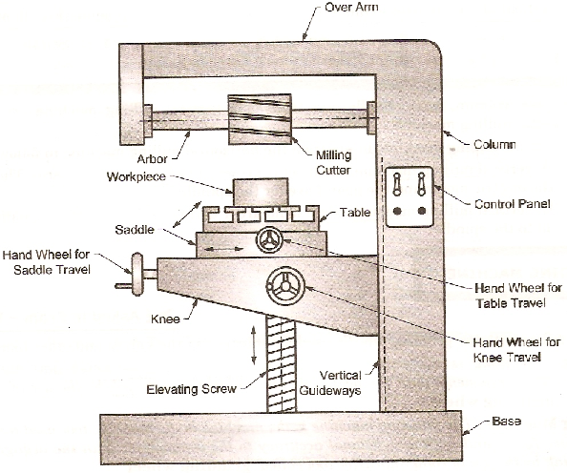
Horizontal Milling Machine

Slide 17
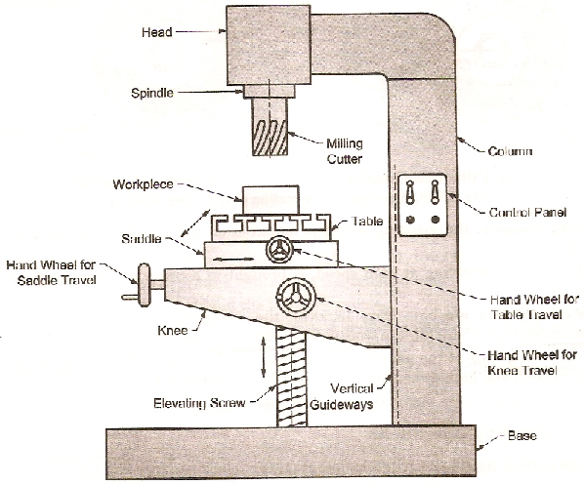
Vertical Milling Machine

Slide 18
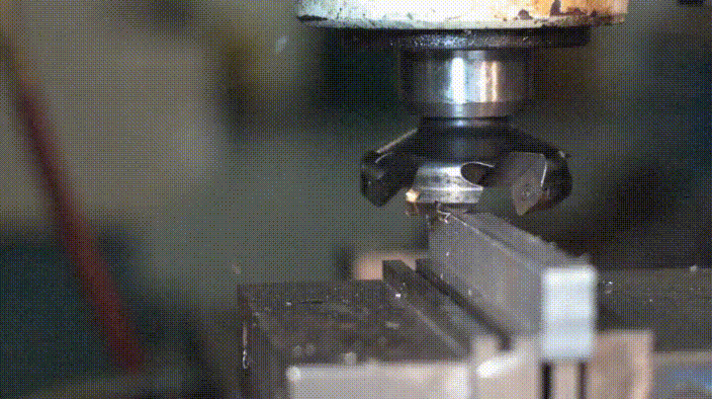
Plane Milling
Plane milling: -The slab milling is the operation of producing flat, horizontal surface parallel to the axis of rotation of a slab-milling cutter. Slab milling is done to remove the material from the upper surface of the work piece. The slab milling cutters is held in the arbor and it may have straight or helical teethes. Both cutters can be used to generate flat surfaces. The require depth of cut can be adjusted by raising the table or the knee and the feed is given by moving the saddle.

Slide 19
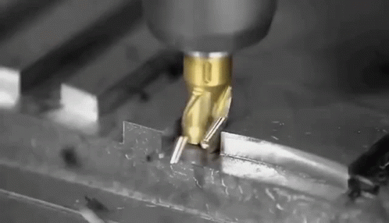
Slot Milling
Slot milling is the operation of producing slots like T-slots, plain slots, dovetail slots etc., in worktable fixtures and other work holding devices. The operation may be performed using lighter end milling cutter, T-slot cutter, dovetail cutter or side milling cutter. The type of cutter selected depends on the shape of the slot to be produced.
Two separate milling cutters are required for milling T-slots. Initially a side cutter or an end milling cutter is used to cut the throat (open slot) starting from one end of the work piece to its other end. A T-slot milling cutter is then used to cut the headspace to the desired dimensions. Similar procedure is followed for cutting a dovetail slot, but a dovetail slot cutter is used in place of T-slot cutter.

Slide 20
INTRODUCTION TO Advanced Manufacturing Systems

Slide 21
1. Introduction
Conventionally, an operator decides and adjusts various machine parameters like feed , depth of cut speed etc depending on type of job , and controls the slide movements by hand. In a CNC Machine functions and slide movements are controlled by motors using computer programs.

Slide 22
What is a CNC Machine?
CNC : Computer Numerical Control (Computer + Numerical Control)
• Numerical control is a programmable automation in which process is controlled by Numbers, Letters, and symbols.
• CNC Machining is a process used in the manufacturing sector that involves the use of computers to control machine tools like lathes, mills and grinders.

Slide 23
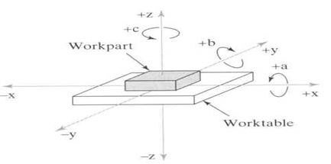
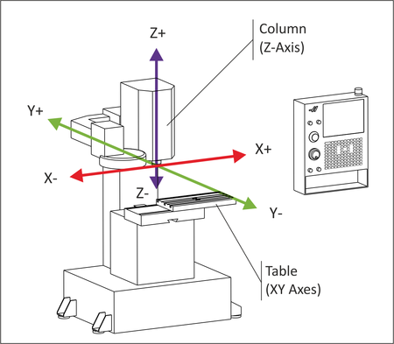
CNC Coordinate Systems
All computer controlled machines are able to accurately and repeatedly control motion in various directions. Each of these directions of motion is called an axis. Depending on the machine type there are commonly two to five axes. Additionally, a CNC axis may be either a linear axis in which movement is in a straight line, or a rotary axis with motion following a circular path.

Slide 24
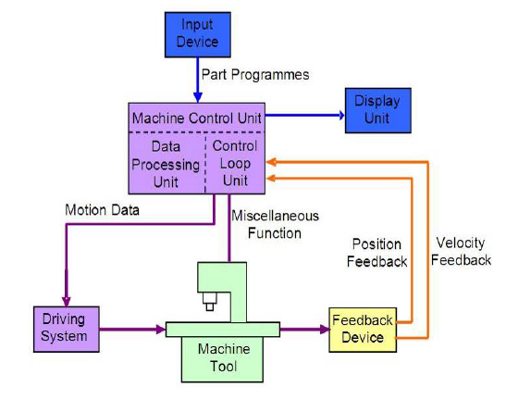
Components of CNC
Fig:- Components of CNC

Slide 25
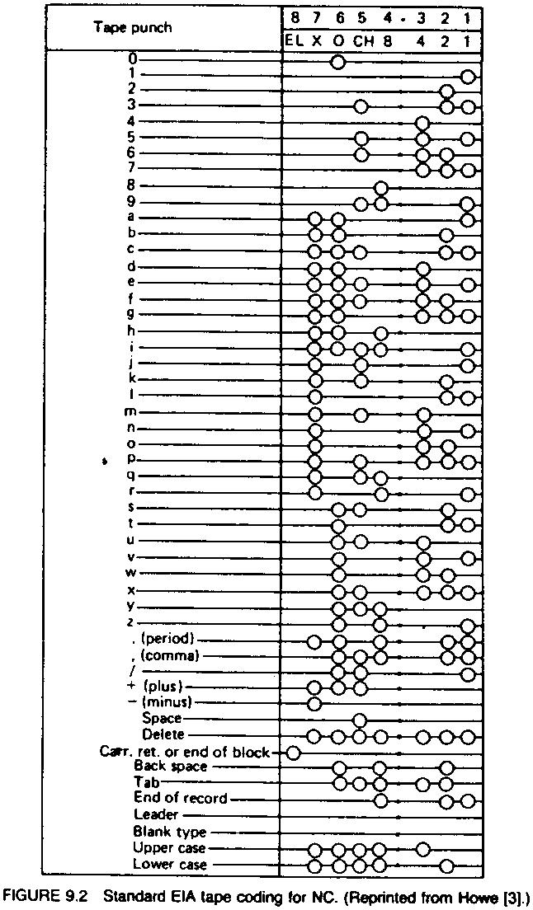
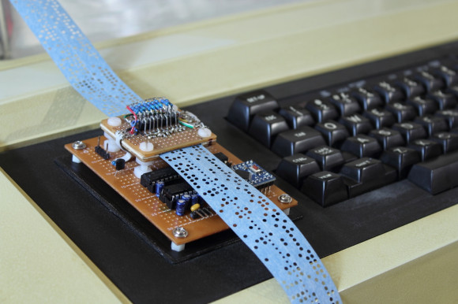
(i) Input Devices: These are the devices which are used to input the part program in the CNC machine. There are different input devices used and these are punch tape reader, magnetic tape reader, floppy drive, USB Flash Drive etc.

Slide 26
(ii) Machine Control Unit (MCU): It is the heart of the CNC machine. It performs all the controlling action of the CNC machine, the various functions performed by the MCU are:
It reads the coded instructions fed into it.
It decodes the coded instruction.
It implements interpolation (linear, circular and helical ) to generate axis motion commands.
It feeds the axis motion commands to the amplifier circuits for driving the axis mechanisms.
It receives the feedback signals of position and speed for each drive axis.
It implements the auxiliary control functions such as coolant or spindle on/off and tool change.

Slide 27
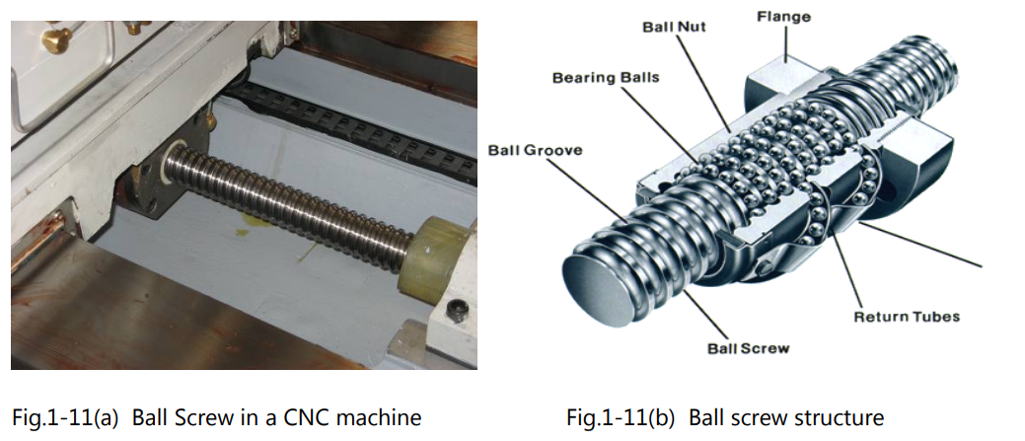
(iii) Machine Tool: A CNC machine tool always has a slide table and a spindle to control of the position and speed. The machine table is controlled in X and Y axis direction and the spindle is controlled in the Z axis direction.
(iv) Driving System: The driving system of a CNC machine consists of amplifier circuits, drive motors and ball lead screw. The MCU feeds the signals (i.e. of position and speed) of each axis to the amplifier circuits. The control signals are then augmented (increased) to actuate the drive motors. And the actuated drive motors rotate the ball lead screw to position the machine table.

Slide 28
(v) Feedback System: This system consists of transducers that acts like sensors. It is also called as measuring system. It contains position and speed transducers that continuously monitor the position and speed of the cutting tool located at any instant. The MCU receives the signals from these transducers and it uses the difference between the reference signals and feedback signals to generate the control signals for correcting the position and speed errors.
(vi) Display Unit: A monitor is used to display the programs, commands and other useful data of CNC machine.

Slide 29
CNC Machines-Advantages/Disadvantages
Advantages:
High Repeatability, Accurate and Precision
Volume of production is very high
Very efficient in producing Complex contours/surfaces with high reliability and precision.
Flexibility in job change, automatic tool settings, that enables less scrap and will reduce idle time in production leads to high productivity.
Quick response to the change in design that gives edge in the market.
Product life cycle can be reduced.
More safe, higher productivity and better quality
Less paper work, faster prototype production, reduction in lead times
Disadvantages:
Initial investment is high
Skilled and trained operators is required to setup operation
Computers and programming knowledge required
Maintenance is difficult.

Slide 30
Applications of CNC Machining
CNC machining is a manufacturing process used in a variety of industries, including automotive, aerospace, construction, and agriculture.
CNC machining processes are suitable for a variety of engineering materials, including metals (such as aluminum, brass, stainless steel, alloy steel, etc.), plastics (such as PEEK, PTFE, nylon, etc.), wood, foam, composite materials, etc.

Slide 31
3D PRINTING
Introduction
3D printing or additive manufacturing is a process of making three dimensional solid objects from a digital file.
The creation of a 3D printed object is achieved using additive processes. In an additive process an object is created by laying down successive layers of material until the object is created. Each of these layers can be seen as a thinly sliced cross-section of the object.
3D printing is the opposite of subtractive manufacturing which is cutting out / hollowing out a piece of metal or plastic with for instance a milling machine.
3D printing enables you to produce complex shapes using less material than traditional manufacturing methods.

Slide 32
How Does 3D Printing Work?
It all starts with a 3D model. It can be created from the ground up or downloaded from a 3D library.
3D Software
There are many different software tools available. From industrial grade to open source.
Now that a printable file is available, the next step is to prepare it for the 3D printer. This is called slicing.
Slicing: From printable file to 3D Printer
Slicing basically means slicing up a 3D model into hundreds or thousands of layers and is done with slicing software.
When the file is sliced, it’s ready for 3D printer. Feeding the file to the printer can be done via USB, SD or Wi-Fi. The sliced file is now ready to be 3D printed layer by layer.

Slide 33
Examples of 3D Printing
consumer products (eyewear, footwear, design, furniture)
industrial products (manufacturing tools, prototypes, functional end-use parts)
dental products
prosthetics
architectural scale models & maquettes
reconstructing fossils
replicating ancient artefacts
reconstructing evidence in forensic pathology
movie props

